Slide 1
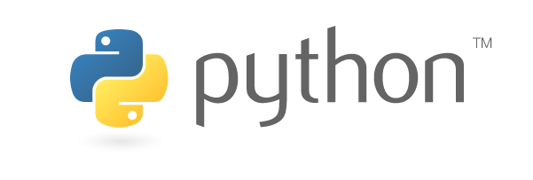
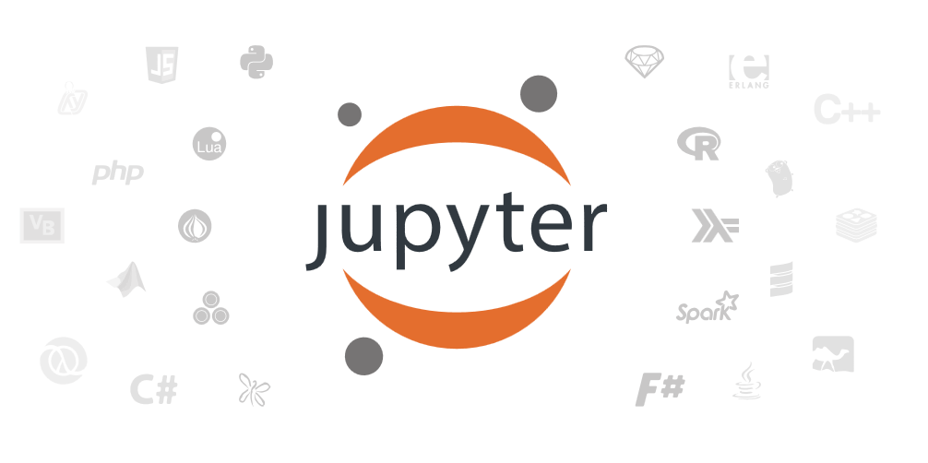

Slide 2
Reproducible vs Replicable

Slide 3
 |  | Data
 |  | Same | Different
Code | Same
 | Different

Slide 4
 |  | Data
 |  | Same | Different
Code | Same | Reproducible
 | Different

Slide 5
 |  | Data
 |  | Same | Different
Code | Same | Reproducible | Replicable
 | Different

Slide 6
 |  | Data
 |  | Same | Different
Code | Same | Reproducible | Replicable
 | Different | Robust

Slide 7
 |  | Data
 |  | Same | Different
Code | Same | Reproducible | Replicable
 | Different | Robust | Generalisable

Slide 8
Barriers to reproducible work

Slide 9
Is not considered for promotion
Requires additional skills
Plead the 5th
Barriers to reproducible work
Support additional users
Takes time
Held to higher standards than others
Publication bias towards novel findings

Slide 10
Jupyter Notebook
http://jupyter.org

Slide 11
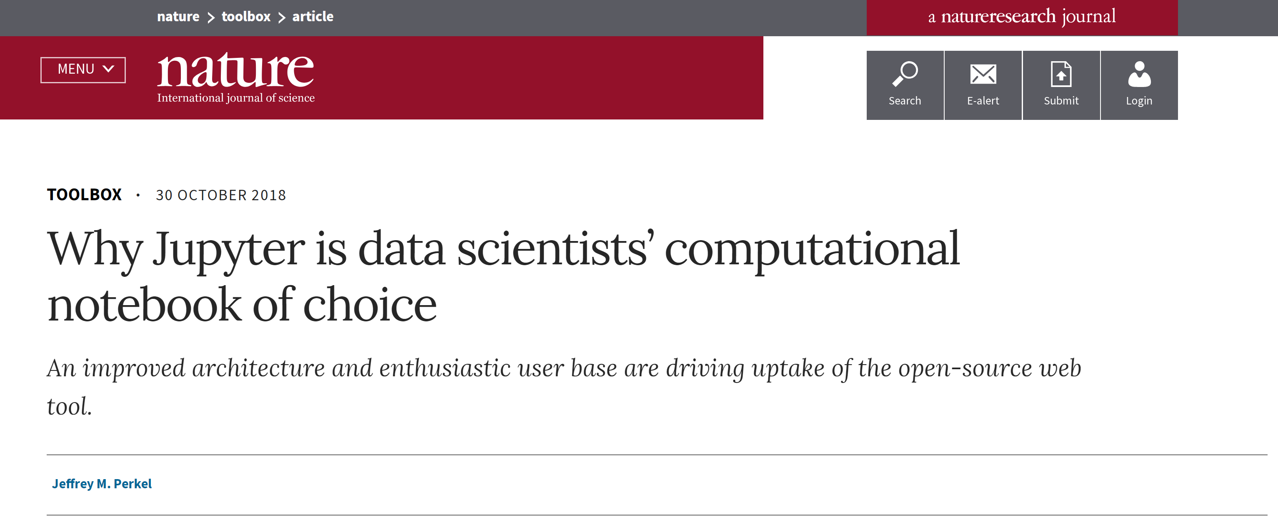
JupyterLab creates a computing environment and can be run anywhere
can view, edit, and execute from the web browser interface
customize JupyterLab to fit their workflow

Slide 12
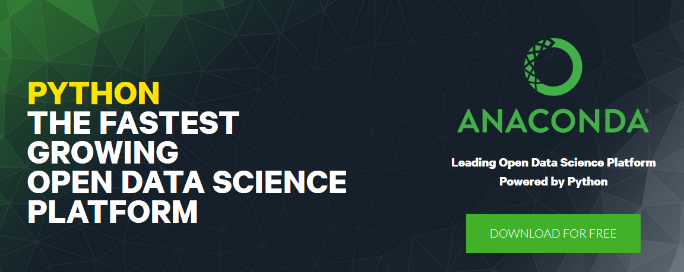

Slide 13
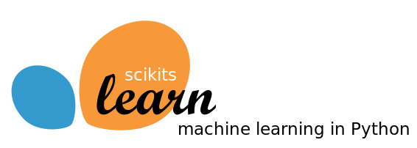
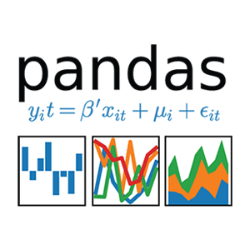
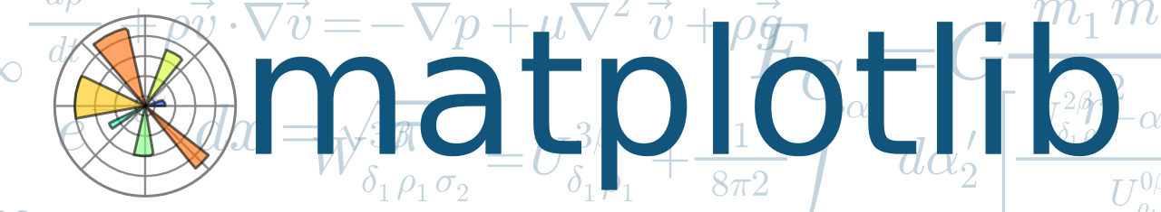
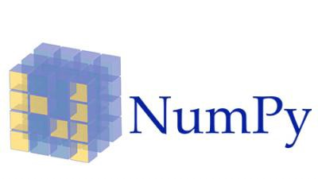

Scikit-learn (formerly scikits.learn) is a free software machine learning library for the Python programming language.
Python is a programming language that lets you work more quickly and integrate your systems more effectively
pandas is an open source providing high-performance, easy-to-use data structures and data analysis tools for the Python programming language.
Matplotlib is a Python 2D plotting library.
NumPy is the fundamental package for scientific computing with Python. It contains among other things: a powerful N-dimensional array object, sophisticated (broadcasting) functions
Seaborn is a Python data visualization library based on matplotlib.

Slide 14
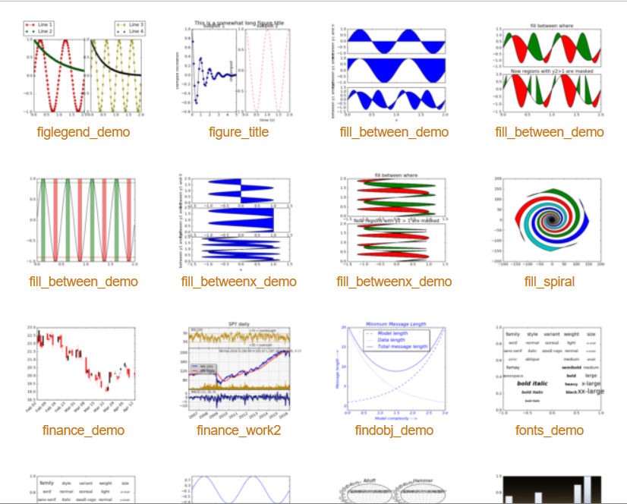
Matplotlib gallery
Click each example to see source code

Slide 15
Examples and Hands-on

